Slide 1
Process Scheduling

Slide 2
Agenda
Recap
General scheduling mechanism
Metrics and goals of scheduling
Scheduling algorithms: SJF, STCF, RR, MLFQ, EDF
Case studies: UNIX, Solaris, Windows XP
Proportional share scheduler: case of Linux
Scheduling in multiprocessors
Evaluating scheduling algorithms

Slide 3
Recap
Concept of process
Loosely speaking, anything that runs on the CPU
System calls to control what a process does (other than computing)
Creation of new process/thread
Communicating with another process/thread: message passing, shared memory, event signal
Saving and restoring the context of a process
Multithreading libraries

Slide 4
General scheduling mechanism
Process scheduling is the activity of selecting the process that will run next on the CPU
If the scheduler needs to run in the kernel mode, there has to be a mode switch in the currently running process before scheduling can take place
The mode switch is usually a result of a system call or an interrupt
A scheduling decision may have to be taken only on a long-latency system call and some interrupts such as the timer interrupt
A scheduler saves the context of the currently running process, selects a process from the ready queue, restores the context of selected process

Slide 5
General scheduling mechanism
The scheduler can be invoked in four possible circumstances
The currently running process goes on a long-latency system call i.e. transitions from running to sleep state
A new process is created or a process completes a long-latency system call i.e., a process transitions from created to ready or from sleep to ready
The currently running process terminates
The currently running process receives a timer interrupt
The first and the third cases lead to non-preemptive or co-operative scheduling
The remaining two cases lead to pre-emptive scheduling

Slide 6
Goals of process scheduling
A scheduling algorithm can target a subset of the following
Maximize throughput: rate at which processes complete (a performance metric)
Minimize turnaround time: time of completion minus time of arrival (a performance metric)
Average, maximum, standard deviation?
Minimize waiting time in the ready state
Direct measure of scheduler efficiency
Average, maximum, standard deviation?
Minimize response time (a fairness metric)
Time to the next I/O call (read/write to a file)
Important for interactive systems
Average, maximum, standard deviation?

Slide 7
Scheduling algorithms: FCFS
Non-preemptive first-come-first-serve
May lead to a convoy effect if one process has large CPU bursts and others have small CPU bursts
In the worst case, FCFS has an unbounded average waiting time

Slide 8
Scheduling algorithm: SJF
Non-preemptive shortest next CPU burst scheduling
Popularly known as shortest job first scheduling
Provably optimal that achieves the minimum average waiting time and average turnaround time
Drawback: need to know future CPU bursts
One popular way of estimating CPU bursts is exponential averaging: s(n+1) = at(n) + (1-a)s(n)
Need to start with a guess for s(0), but little effect in long run; “a” is a parameter of the estimation algorithm
Pre-emptive version is called shortest remaining time first (SRTF) or shortest time to completion first (STCF)
Needed for handling arrival of short jobs at any time

Slide 9
Why SJF is optimal
Intuitively, SJF minimizes the overall waiting time
Consider a set of n processes
Consider a schedule S = <P₁, P₂, P₃, …, P_{n}>
Process P_{k} has a CPU burst of length t_{k}
Average TA time of this schedule = TA_{S} = (t₁+(t₁+t₂)+(t₁+t₂+t₃)+…+(t₁+t₂+…+t_{n}))/n
We will gradually convert S to SJF and in each step we will improve the average TA time
Let P_{k} be the first process in S such that t₁<t₂<t₃<…<t_{k-1} > t_{k} i.e., this is the first point where S appears to deviate from SJF
We derive schedule S’ from S by moving P_{k} forward to a position, say, after P_{j} such that t₁<t₂<…<t_{j}<t_{k}<t_{j+1}<…<t_{k-1}

Slide 10
Why SJF is optimal
Consider a set of n processes
Consider a schedule S = <P₁, P₂, P₃, …, P_{n}>
Average TA time of this schedule = TA_{S} = (t₁+(t₁+t₂)+(t₁+t₂+t₃)+…+(t₁+t₂+…+t_{n}))/n
We derive schedule S’ from S by moving P_{k} forward to a position, say, after P_{j} such that t₁<t₂<…<t_{j}<t_{k}<t_{j+1}<…<t_{k-1}
Completion times of P₁, P₂, …, P_{j} remain unchanged
Completion times of P_{j+1}, …, P_{k-1} increase by t_{k} each
Total increase in TA time = (k-1-j-1+1)*t_{k}
Completion time of P_{k} decreases by t_{j+1}+t_{j+2}+…+t_{k-1}
Since t_{k} is less than each of these terms, the total decrease in TA time is bigger than the total increase
Completion times of P_{k+1}, …, P_{n} remain unchanged

Slide 11
Why SJF is optimal
Consider a set of n processes
Consider a schedule S = <P₁, P₂, P₃, …, P_{n}>
Average TA time of this schedule = TA_{S} = (t₁+(t₁+t₂)+(t₁+t₂+t₃)+…+(t₁+t₂+…+t_{n}))/n
We derive schedule S’ from S by moving P_{k} forward to a position, say, after P_{j} such that t₁<t₂<…<t_{j}<t_{k}<t_{j+1}<…<t_{k-1}
We have proved that TA_{S’} < TA_{S}
In the next step, we derive schedule S’’ by correcting the position of the next process that appear to deviate from SJF
In each step, the turnaround time goes down leading finally to SJF with the minimum turnaround time

Slide 12
Scheduling algorithms: Priority
Each process is assigned a priority
Either by kernel based on the resource usage profile of the process or externally by the user
The process with the highest priority is scheduled
Can be pre-emptive or non-preemptive
A steady flow of CPU bursts from the high-priority processes can starve the low-priority ones
Age-based priority modulation solves this problem
SJF is a special-case priority scheduling policy
Priority is inversely proportional to the next CPU burst length

Slide 13
Scheduling algorithms: Round-robin
Pre-emptive quantum scheduling
The ready queue is treated as a circular FIFO and each process in the FIFO order is assigned a fixed time slice or quantum for execution
If the running process goes to sleep or terminates before the expiry of the quantum, the next process in the FIFO order is scheduled
If the running process’s quantum expires, it is put back at the tail of the ready queue
The time quantum should be chosen to be larger than the context switch overhead
Too large a time quantum leads to FCFS sheduling
80% of the CPU bursts should be shorter than the time quantum: is this thumb rule useful?

Slide 14
Scheduling algorithms so far
SJF, STCF: optimizes turn-around time, bad for response time
Penalizes response time of long jobs
Unfair
Round-robin: optimizes response time, bad for turn-around time
Gives turn to all jobs
Fair
Notice the trade-off between fairness and performance
Performance is inversely related to fairness

Slide 15
I/O bursts
When a process initiates an I/O, it goes to blocked state and de-scheduled
The scheduler picks another job for running
Overlaps I/O burst of a process with the CPU burst of another process
Ideally, the scheduler’s goal is to overlap all I/O bursts with available CPU bursts
The scheduler views a process as a sequence of interleaved CPU and I/O bursts
A scheduling algorithm simply schedules a CPU burst from among the CPU bursts of all ready processes
STCF or SJF needs to estimate the next CPU burst length of each ready process

Slide 16
I/O bursts
Consider two processes A and B
A has five CPU bursts each of 10 ms length interspersed by 10 ms long I/O bursts
B has one CPU burst of length 50 ms and no I/O
SJF or SCTF would schedule A first for 10 ms, then B for 10 ms, then A for 10 ms, …
Round-robin with time quantum of 5 ms would schedule A (could schedule B also), B, A, B, B, A, B, A, B, B, A, …
In general, a scheduling algorithm schedules CPU bursts only
I/O bursts get taken care of on their own

Slide 17
Multi-level feedback queue (MLFQ)
Recap: two primary goals of a scheduling policy
Minimize turnaround time (performance goal)
Schedule short jobs first
Minimize response time (fairness goal)
Schedule I/O-intensive jobs without much delay
Need to achieve both goals without any knowledge of future CPU burst lengths of jobs
Recall that SJF minimizes turnaround time with future knowledge, but hurts fairness; Round-robin offers fairness, but hurts turnaround time
MLFQ is a family of scheduling algorithms that tries to achieve these goals

Slide 18
Multi-level feedback queue (MLFQ)
Why both goals are important?
For handling different kinds of processes
Foreground processes would require a scheduling policy that minimizes response time e.g., round-robin
Background processes are usually CPU-bound, less interactive, and need to minimize turnaround time
How about multiple ready queues each having its own policy?
One for each type of processes (how to know type?)
Order queues by priority for scheduling across queues
Within a queue, the scheduling algorithm depends on the type of the processes in the queue

Slide 19
Multi-level feedback queue (MLFQ)
Multiple ready queues each having its own policy
Drawback: need to know the type/priority of a process beforehand to decide its ready queue
Drawback: a process cannot migrate from one queue to another even if its behavior has changed
The priority of a process may change over its life time
Such a static arrangement is not attractive
Multi-level feedback queue (MLFQ)
Maintain multiple ready queues ordered by priority
Processes within each queue are scheduled using RR
A new process always enters the highest priority queue, but can move between queues during its life

Slide 20
Multi-level feedback queue (MLFQ)
Multi-level feedback queue (MLFQ)
A process is enqueued in exactly one queue at any given point in time
Scheduling rules
Processes in a given queue Q are scheduled using RR provided all queues at higher priority levels than Q are empty
If a running process uses up the complete scheduling quantum of RR, it is inferred to be a less interactive process and demoted one level down in priority i.e., enqueued into the next lower priority queue
If a running process invokes a blocking I/O before completing the scheduling quantum of RR, its priority is not changed and kept in the same queue

Slide 21
Multi-level feedback queue (MLFQ)
Multi-level feedback queue (MLFQ) case studies
Assume that all queues have the same scheduling quantum of T
Suppose the ready queues are Q1, Q2, …, Qn ordered by increasing priority levels
Scenario#1: one job with long CPU burst
Runs for T time in Qn, another T time in Qn-1, …, T time in Q2, settles in Q1 for the rest of its life

Slide 22
Multi-level feedback queue (MLFQ)
Multi-level feedback queue (MLFQ) case studies
Scenario#2: two jobs A and B; A has a long CPU burst and B has a short CPU burst; both bursts are bigger than T; B arrives later than A but before A finishes
When B arrives, A will be in a lower priority queue; so B gets scheduled immediately after arriving
B will keep getting higher priority until it finishes or joins A in the same queue whichever happens earlier
This scenario shows how MLFQ approximates SJF by assuming that all jobs have short CPU bursts to begin with
If they don’t, they will gradually settle with lower priority
Note that this is only an approximation and deviation from SJF can be large in certain pathological scenarios

Slide 23
Multi-level feedback queue (MLFQ)
Multi-level feedback queue (MLFQ) case studies
Scenario#3: two jobs A and B; A has a long CPU burst and B is I/O-intensive having short CPU bursts (less than T) interspersed with I/O bursts
B will stay in Qn throughout its life while A will gradually get demoted to Q1
A will be scheduled only when B is doing I/O because only at that time, Qn will be empty
This scenario shows how MLFQ minimizes response time by giving higher priority to more interactive jobs
This scenario also opens up two drawbacks of MLFQ presented so far
What if there is a large number of I/O-intensive processes? They can completely monopolize the CPU and starve other processes
What if someone purposefully writes a program that has CPU bursts of length 0.99T and a very short I/O? Can monopolize CPU

Slide 24
Multi-level feedback queue (MLFQ)
Multi-level feedback queue (MLFQ) drawbacks
The second drawback shows a possible DoS attack
Additional drawback: what if a process exhibits different behavior during different phases of execution?
Switches between being CPU-bound and I/O-bound
Easy to imagine a program that initially takes a lot of inputs from stdin or other files and then computes on the data and finally, writes a lot of outputs to stdout or files
Starts of as I/O-intensive, then becomes CPU-bound, and finally, becomes I/O-intensive
One-way switch from I/O-intensive to CPU-bound is already handled, but not the other way
Need to have a mechanism of priority boost

Slide 25
Multi-level feedback queue (MLFQ)
Two general ways to do priority boost in MLFQ
Gradual boost: move a process one priority level up if it fails to use up the scheduling quantum for N consecutive schedule instances
Possible to devise other gradual boosting algorithms
One-shot boost: move all processes to Qn at a regular interval of S timer ticks
For both, we need to fix the parameter N or S
Fixing any such constants is a difficult task because a designer would not know what would work best for a large collection of jobs of different kinds
Priority boost addresses the first and the third drawbacks adequately

Slide 26
Multi-level feedback queue (MLFQ)
To avoid the DoS attack, MLFQ needs to revise its priority demotion algorithm
Revised algorithm: keep an accumulated sum of CPU time consumed by a process in a queue; once the sum crosses a threshold t, it is moved down by one priority level
Fixing the threshold t for each queue is another difficult job
An easy solution could be to set t=T for all queues
A process’s accumulated CPU time is reset to zero when it enters a new queue
Highly interactive jobs will lose priority slowly over time while a malicious CPU hog process will lose priority faster

Slide 27
Multi-level feedback queue (MLFQ)
Multi-level feedback queue (MLFQ) parameters
Another important parameter in MLFQ is the scheduling quantum T
We have assumed it to be same for all queues, but need not be
It makes sense to have a smaller T for higher priority queues so that the scheduler can cycle through all the jobs in those queues quickly
These are highly interactive jobs
In general, T should grow as one moves down the priority levels
Also, it makes sense to have a large T for low priority queues because these processes have large CPU bursts

Slide 28
Multi-level feedback queue (MLFQ)
MLFQ parameters
Number of priority levels (number of queues)
Scheduling quantum of each queue
Algorithm for priority demotion
How frequently invoked?
Algorithm for priority boost
How frequently invoked?
Some implementations hardcode the constants based on empirical study with a large pool of jobs
Some implementations compute the parameters at run-time by observing system behavior

Slide 29
Scheduling algorithms: Deadlines
In real-time systems, usually a deadline is attached with each process
Scheduling algorithm needs to minimize the average, maximum, or standard deviation of overshoot
Two types of processes
With hard deadlines (must be met)
With soft deadlines (minimize some function of overshoot)
Tempting to sort the processes by deadline and scheduling them in earliest-deadline-first order
No guarantee on overshoot if all the deadlines cannot be met
How to handle a continuous flow of processes?
All deadlines not known a priori (pre-emptive EDF)

Slide 30
Scheduling algorithms: Deadlines
How to make sure that the owner of a process submits the true deadline?
Possible to submit an earlier deadline than the actual to gain priority in scheduling
Particularly problematic if the user knows that the scheduling algorithm is EDF
Any priority scheme that depends on deadline alone will suffer
No solution would be perfect in this case
If there are too many processes, the scheduler could switch to round-robin
Important for the user to specify correct deadlines when the hard deadlines are mission-critical

Slide 31
Case study: UNIX
Priority-based fixed quantum scheduling
Priority of a process may change during its life time
A higher priority value indicates lower priority
The timer interrupt handler keeps track of the CPU usage of the currently running process
Every one second, the priorities of all the user mode processes are updated by the timer interrupt handler
Set CPU usage of each process to CPU usage/2
Set priority value of each process to (base priority + CPU usage/2). The base priority is the minimum user mode priority value. Priority is inversely related to CPU usage.

Slide 32
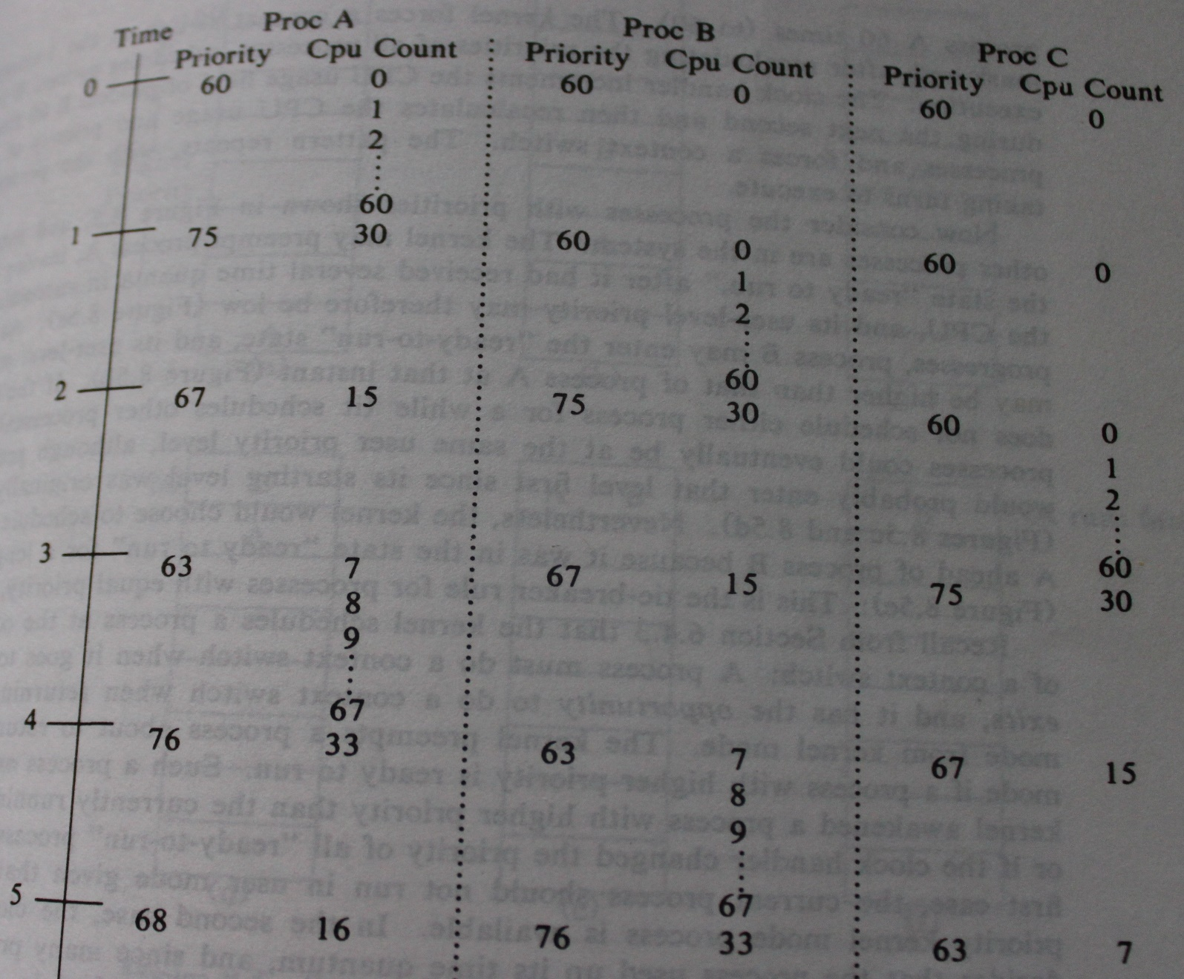
Case study: UNIX
Priority-based fixed quantum scheduling

Slide 33
Case study: UNIX
Priority-based fixed quantum scheduling
A process on entering the kernel mode receives a priority value lower than the user mode base priority indicating a higher priority than all user mode processes
A process about to enter the sleep state (in kernel mode) receives a predetermined priority value
Value depends on the reason to sleep
I/O calls from lower levels of the kernel receive very high priority because these calls hold a lot of resources
Disk I/O always receives higher priority than a process waiting for some memory resources
This priority is used to schedule the process right after it returns to the ready queue at the end of the sleep (still in kernel mode)

Slide 34
Case study: UNIX
Priority-based fixed quantum scheduling
A switch from kernel to user mode sets the process priority value to at least the user mode base priority
The priority of a process can be controlled by the owner of the process through the nice() call
Takes an integer argument, which is usually non-negative
The passed argument is added to the priority value of the process
The value of the argument is usually called the “nice value” indicating how nice the process is to the other processes
The nice value, the priority value, and the CPU usage value of a process are stored in the process table entry
Forked children inherit the nice value of the parent
Priority ties are broken by scheduling the process with a larger waiting time in the ready queue

Slide 35
Case study: Solaris
Four classes of processes
Time sharing, interactive, system, and real-time
A user process is classified as time sharing unless it is interactive (e.g., GUI process) or real-time
Multi-level feedback queue scheduling with queues ordered by priority; a lower priority queue can be scheduled only if all higher priority queues are empty
The processes in the highest priority queue get the smallest time quantum (can be switched quickly so that all high priority processes make some progress)
When a process returns from sleep state to ready state, its priority is boosted to somewhere between 50 and 59

Slide 36
Case study: Solaris
Interactive class executes a similar scheduling algorithm as the time sharing class
The GUI processes are assigned the highest priority
System class includes all kernel processes
User processes executing in kernel mode are not in this class
Scheduler, system daemons, etc. are in this class
Each system process has a pre-determined fixed priority, based on which they get scheduled
Real-time processes are time-critical
Assigned highest global priority

Slide 37
Case study: Solaris
At the time of selecting a new process for scheduling
The scheduler translates all local priorities within each class into global priorities
Done through a pre-determined priority order among the classes
Selects the process with the highest global priority
If there are multiple such processes, all of them are chained up in a single special queue
This special queue is scheduled in a round-robin fashion with a fixed pre-determined time quantum assigned to each process
A process is pre-empted if it goes to sleep state, or its time quantum expires, or a new higher-priority process arrives

Slide 38
Case study: Windows XP
Pre-emptive priority-based scheduling
42 priority levels
Six priority classes: REALTIME, HIGH, ABOVE_NORMAL, NORMAL (this is default), BELOW_NORMAL, and IDLE
Seven relative priority levels within each priority class: TIME_CRITICAL, HIGHEST, ABOVE_NORMAL, NORMAL (this is default), BELOW_NORMAL, LOWEST, and IDLE
The global priority level of a process is determined based on its priority class and its priority level within the class
The Win32 kernel thread library allows the user to control these two parameters from the user program

Slide 39
Case study: Windows XP
Pre-emptive priority-based scheduling
The priority has an inverse relationship with CPU usage like in UNIX
A process returning to the ready queue from sleep state undergoes a priority boost
The amount of boost depends on the reason for sleep
A process sleeping on keyboard I/O always gets a bigger priority boost compared to one sleeping on disk I/O
Interactive processes use a different variable-quantum scheduling algorithm (next slide)

Slide 40
Case study: Windows XP
Pre-emptive priority-based scheduling
The process currently selected on the screen is called a foreground process and everything else is a background process
The foreground processes always get a bigger quantum than the background processes
When a background process moves to foreground, its quantum is multiplied by a constant positive integer larger than one (usually three)

Slide 41
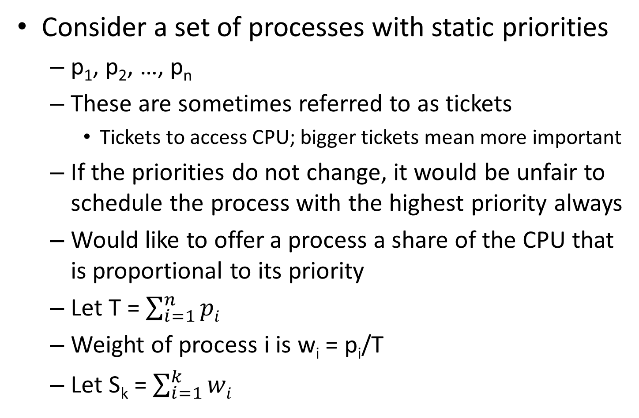
Proportional share scheduling
Consider a set of processes with static priorities
p₁, p₂, …, p_{n}
These are sometimes referred to as tickets
Tickets to access CPU; bigger tickets mean more important
If the priorities do not change, it would be unfair to schedule the process with the highest priority always
Would like to offer a process a share of the CPU that is proportional to its priority
Let T = $\sum_{i=1}^{n}{pi}$
Weight of process i is w_{i} = p_{i}/T
Let S_{k} = $\sum_{i=1}^{k}{wi}$

Slide 42
Proportional share scheduling
Randomized scheduling algorithm
Popularly known as lottery scheduling
Generate a random number X uniformly distributed in [0, 1)
Schedule process k such that S_{k-1} < X ≤ S_{k}
Probability that process k is scheduled = Pr_{k} = Pr(S_{k-1} < X ≤ S_{k}) = Pr(X ≤ S_{k}) – Pr(X ≤ S_{k-1}) = S_{k} – S_{k-1} = w_{k}
Note the elegance of the algorithm: needs absolutely no per-process state to be maintained
Only downside is that in a short span of time, it may not be as fair as a deterministic algorithm would be
In the long run, the scheduler will achieve the goal of proportional share as Pr_{k} tends to w_{k}

Slide 43
Proportional share scheduling
Deterministic scheduling algorithm
Popularly known as stride scheduling algorithm
Let stride of process k be S_{k} = LCM(p₁, p₂, …, p_{n})/p_{k}
Let progress of process k be P_{k} initialized to 0
The scheduling algorithm schedules the process k with minimum P_{k} and sets P_{k} to P_{k} + S_{k}
Example: processes A, B, C have priorities 10, 20, 30
Schedule: A, B, C, C, B, C, A, B, C, C, B, C, …
Even within short span it offers proportional share of CPU to the processes

Slide 44
Proportional share scheduling
Deterministic scheduling algorithm
Downsides
Needs to maintain per-process progress
Needs an efficient algorithm to find the process with minimum progress from among all processes
Dealing with a new process is very problematic because if we initialize its progress to zero, it will monopolize the CPU for quite some time
Completely fair scheduler (CFS) of Linux implements the basic idea of stride scheduling
Short-term fairness is important
Optimizes data structures to speed up min finding
Updates priorities

Slide 45
Linux CFS
CFS answers two basic questions related to process scheduling
Which process to schedule?
When a process is scheduled, how long should it run before undergoing a context switch?
CFS keeps track of the total number of CPU cycles consumed by each process
Referred to as the virtual runtime (vruntime) of the process
CFS schedules the process with minimum vruntime

Slide 46
Linux CFS
CFS answers two basic questions related to process scheduling
When a process is scheduled, how long should it run before undergoing a context switch?
If a set of n processes has equal priority, max(min_granularity, sched_latency/n) is the amount of time each process runs before undergoing a context switch
Over each window of sched_latency time, CFS maintains proportional share
Usually processes have different priorities
Need to take this into account in CFS

Slide 47
Linux CFS
Priorities in CFS are derived from nice values
Nice values range from -20 to +19 with zero being the default nice value of a process
Nice value of a process can be changed through nice() function call
Higher the nice value, lower is the priority
+19 represents the lowest priority
priority value = 120 + nice value; ranges from 100 to 139
A lower priority value means higher priority
CFS maps these forty nice values (or equivalently forty priority values) to integer weights maintaining monotonicity
Lower nice value means higher weight

Slide 48
Linux CFS
Nice value to weight mapping
CFS sets a goal that if the nice value of a process goes down by one the process will get 10% more CPU time
Understanding how this goal is translated to weights
Consider two processes A and B having the same nice value n (and hence the same weight w(n))
sched_latency=2t is divided into the two processes equally and let’s suppose each process gets a time quantum of t
Suppose A decreases its nice value by one; the CFS goal says that now sched_latency of 2t will be divided among A and B as 1.1t and 0.9t respectively (proportional share)
Notice how changing A’s nice value affects the quanta of both processes due to a fixed sched_latency window
So, we need w(n-1)/w(n) = 1.1/0.9 = 1.22
CFS approximates this ratio as 1.25

Slide 49
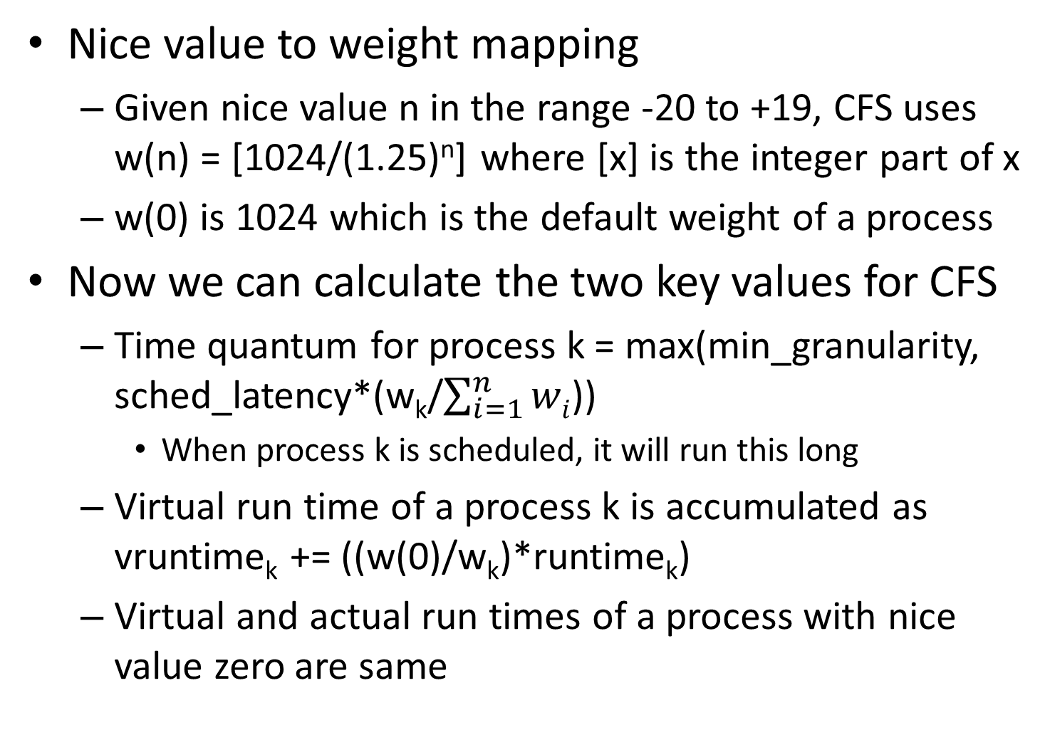
Linux CFS
Nice value to weight mapping
Given nice value n in the range -20 to +19, CFS uses w(n) = [1024/(1.25)^{n}] where [x] is the integer part of x
w(0) is 1024 which is the default weight of a process
Now we can calculate the two key values for CFS
Time quantum for process k = max(min_granularity, sched_latency*(w_{k}/$\sum_{i=1}^{n}{wi}$))
When process k is scheduled, it will run this long
Virtual run time of a process k is accumulated as vruntime_{k} += ((w(0)/w_{k})*runtime_{k})
Virtual and actual run times of a process with nice value zero are same

Slide 50
Linux CFS
CFS scheduling policy is simple: schedule the process with minimum vruntime
Operations
find and delete the entry of the process with minimum vruntime from ready queue (needed at the time of scheduling the process)
insert a process into the ready queue (needed when a process enters or returns to ready state)
At first blush, a binary heap appears to be the ideal data structure for maintaining the ready processes
Finding the process with minimum vruntime has O(1) time
But needs to maintain the heap property on deletion and insertion (both require O(log n) time, n being the number of processes)

Slide 51
Linux CFS
CFS scheduling policy is simple: schedule the process with minimum vruntime
Operations
find and delete the entry of the process with minimum vruntime from ready queue (needed at the time of scheduling the process)
insert a process into the ready queue (needed when a process enters or returns to ready state)
At first blush, a binary heap appears to be the ideal data structure for maintaining the ready processes
Finding the process with minimum vruntime has O(1) time
But needs to maintain the heap property on deletion and insertion (both require O(log n) time, n being the number of processes)

Slide 52
Linux CFS
CFS scheduling policy is simple: schedule the process with minimum vruntime
One drawback of binary heap is that the implementation of a heap inside the Linux kernel is array-based and the way the space for the array is allocated requires contiguous physical memory
Getting large contiguous physical memory may be difficult
May need to move several processes to create a large enough free region in physical memory
Of course, it is possible to rewrite the binary heap implementation to not require contiguous memory
However, there are other equally good solutions

Slide 53
Linux CFS
CFS scheduling policy is simple: schedule the process with minimum vruntime
CFS maintains the ready processes in a red-black tree which is a balanced binary search tree
Finding the process with minimum vruntime and deleting it has O(log n) time complexity
Insertion also has O(log n) time complexity
Note that a linked list of ready processes would lead to very poor performance
Number of processes is usually several hundreds to thousand in busy servers

Slide 54
Linux CFS
Observations
Weight of a process does not change throughout its life unless explicit nice() calls are made by the user program
Default nice value of a kernel process is negative to make sure that it enjoys a bigger weight that a default user process
Interactive processes are expected to have the lowest virtual runtime because they do not use CPU much
A process can monopolize the CPU for a long time after returning from sleep/blocked state until its virtual runtime catches up with others’
To avoid this problem, when a process returns from the sleep/blocked state, its virtual runtime is set to the current minimum virtual runtime among all ready processes

Slide 55
Multiprocessor scheduling
Two important aspects: load balancing and data affinity
Where does the OS code run? Options:
A group of processors dedicated to carry out kernel activities (known as asymmetric scheduling)
A single OS node simplifies OS design and improves performance
The OS code runs on the processor that asks for a kernel service (known as symmetric scheduling)
Design of the ready queue
Centralized (one queue: SQMS), distributed (one per processor: MQMS), hierarchical (combination of both)

Slide 56
Data affinity in multiprocessors
A process can be scheduled on different processors during different quanta given to the process
Known as process migration
Each migration comes with the overhead of cache warm-up and possible remote memory accesses
A process can specify its affinity toward a processor through system calls
Prevents the scheduler from migrating the process to a different processor
A multiprocessor scheduler must be aware of data affinity and the overheads involved in migration

Slide 57
Multiprocessor scheduling: SQMS
SQMS is easy to implement
Whenever a CPU needs to pick a new process to schedule, it can grab one from SQMS following any scheduling algorithm discussed so far
Maintains load balance: each CPU is equally busy
Two major drawback with SQMS
The deletion from and insertion into the ready queue must be serialized and cannot be executed concurrently by multiple CPUs: hurts performance
Can run into correctness problems (e.g., if two CPUs try to grab the process at the head of the queue)
Can severely hurt data affinity

Slide 58
Multiprocessor scheduling: SQMS
SQMS and data affinity
Consider five processes A, B, C, D, E and four CPUs
Each CPU grabs the process at the head of queue
When a process’s time quantum finishes, it is inserted at the tail of the queue
CPU0: A, E, D, C, B, A, …
CPU1: B, A, E, D, C, B, …
CPU2: C, B, A, E, D, C, …
CPU3: D, C, B, A, E, D, …
Notice that a process keeps getting migrated hurting data affinity

Slide 59
Multiprocessor scheduling: SQMS
SQMS and data affinity
One possibility is to keep the set of processes fixed for a CPU
CPU0: A, E, A, E, …
CPU1: B, B, B, B, …
CPU2: C, C, C, C, …
CPU3: D, D, D, D, …
This leads to load imbalance: CPU0 is more loaded than other CPUs

Slide 60
Multiprocessor scheduling: SQMS
SQMS and data affinity
Another possibility is to maintain load balance while minimizing migration
CPU0: A, E, A, A, A, A, …
CPU1: B, B, E, B, B, B, …
CPU2: C, C, C, E, C, C, …
CPU3: D, D, D, D, E, D, …
This leads to migration of E only
Note that every process gets a fair share of CPU time otherwise
In general, both load balance and data affinity cannot be satisfied

Slide 61
Multiprocessor scheduling: MQMS
MQMS uses one ready queue per CPU and as a result, solves the data affinity problem
Processes normally do not migrate from one CPU’s ready queue to another’s
Load imbalance is a problem with MQMS because the number of processes in the ready queues may not be equal all the time
Rebalancing through cross-CPU migration needs to happen periodically
This is sometimes known as work stealing (one CPU steals some work from another CPU)
An important parameter is the frequency of rebalancing
Too frequent: high migration overhead, but good load balance
Less frequent: low migration overhead, but poor load balance

Slide 62
Load balancing in multiprocessors
Distributed and hierarchical ready queue designs may lead to load imbalance
Scheduler’s responsibility is to keep all CPUs equally busy
Receiver-initiated and sender-initiated diffusion (RID and SID)
Also known as pull migration and push migration
RID is invoked on a CPU whose ready queue size has dropped below a threshold; migrates a number of processes from a CPU whose ready queue size is above the threshold
SID is invoked on a CPU whose ready queue size has gone above a threshold

Slide 63
Load balancing in multiprocessors
RID and SID algorithms can work together
In multiprocessor Linux, every 200 ms the SID algorithm is invoked on every CPU and the RID algorithm is invoked whenever the ready queue of a CPU is empty
Load balancing and data affinity have conflicting goals
Achieving both is usually challenging

Slide 64
Linux multiprocessor scheduler
Three popular schedulers in Linux community
O(1) scheduler
Priority-based, derived from MLFQ, uses multiple queues (one per CPU)
CFS
Proportional share-based, derived from stride scheduling algorithm, uses multiple queues (one per CPU)
BFS
Proportional share-based, uses single queue (SQMS)

Slide 65
Evaluating scheduling algorithms
Must evaluate a set of algorithms before picking one
Need to decide the optimization criterion first
Possible example: maximize CPU utilization under the constraint that the maximum response time is T
Possible example: maximize system throughput under the constraint that the turnaround time of each process is linearly proportional to its execution time
Short-burst processes wait less
Once the criterion is decided, a set of candidate algorithms must be evaluated to select the best one

Slide 66
Evaluating scheduling algorithms
Analytical modeling
Design a mathematical model for the entire system that takes as input the description of the scheduling algorithm and the description of the processes possibly in terms of the distribution of arrival times, values of CPU and I/O burst lengths or simply a sequence of CPU and I/O bursts
The model computes the target criterion
Such a model can be as simple as a single formula or as complicated as a queuing model
Usually difficult to capture the real-world behavior of the system, but useful for eliminating some obviously poor scheduling algorithms

Slide 67
Evaluating scheduling algorithms
Simulation
Rigorous simulation must be carried out before selecting a few good candidates
A simulator is a software model of the system, but simpler than the full OS
The simulator can accept real-world user programs and simulate them to evaluate the target criterion
NachOS is a simplified OS simulator
Final phase of the design involves incorporating the shortlisted candidate algorithms in the real OS and evaluating the target criterion

